Slide 2
Purpose of Speakers Bureau Training
During training, volunteers will develop knowledge and skills to:
Define Wellspring Living's mission & vision statements
Have detailed knowledge of our programs and retail stores
Effectively convey this information to an audience
Use accurate messaging and language about DMST & Wellspring Living
Stats: Understanding the impact of the issue
Stories: Who we serve and how they go through our program
Engagement: How the community can get involved and be part of the solution

Slide 3
Prepare for your event...
Know your elevator speech!!!
Be sure to always cover the following topics when you are speaking:
WSL Mission & Vision
Brief History
Our Programs & Services
How to Engage the Community
Your ultimate goals: Inform, Inspire, Motivate

Slide 4
TO TRANSFORM LIVES OF THOSE AT RISK OR VICTIMIZED BY SEXUAL EXPLOITATION

Slide 5
A WORLD WHERE EVERY VICTIM OF SEXUAL EXPLOITATION HAS ACCESS TO TRANSFORMATIVE CARE.
Our mission and vision are designed to help prevent, rescue, and educate about sexual exploitation
We exist to serve those that are victimized and those that are vulnerable

Slide 6
WELLSPRING LIVING — WHAT WE DO —
Wellspring Living is devoted to safeguarding and empowering domestic sex trafficking victims and those at risk to develop the courage to move forward and the confidence to succeed.
Through life-giving residential and community-based programs, girls and young women are provided the opportunity
to live and dream again.
Notes:
We are devoted to safeguarding and empowering domestic sex trafficking victims and those at risk to develop the courage to move forward and the confidence to succeed.
To that end, we provide:
Comprehensive services that balance education, therapy, life skills and career readiness.
Along with a customized plan of care for each participant helps to balance services and measure progress.

Slide 7
WELLSPRING LIVING HISTORY
Wellspring Living has been serving survivors of sex trafficking in the Metro Atlanta area since 2001
2001
WSL opened its first residential program for women 18+
2008
WSL expanded to serve minors (ages 12-17) in partnership with Georgia Baptist
2012
WSL began training and providing mentorship to other like-minded organizations
through our Institute
2014
WSL launched the Women’s Academy in partnership with the YMCA
2018
WSL launched 2 new programs: Women’s Residential Program South, to serve young women (ages 18-21), and the Youth Academy, focused on at-risk high school students (boys and girls ages 14+)

Slide 8
Our Programs & Services
Our programs are designed to provide proper, individualized care for this population.
We offer comprehensive care, focusing on healing the mind, body, & spirit through:
Trauma-Informed Care
Education
Personal & Professional Development
RESIDENTIAL CARE
GIRLS’ RESIDENTIAL PROGRAM (ages 12-17)
WOMEN'S RESIDENTIAL PROGRAM - NORTH
(ages 18-32)
WOMEN'S RESIDENTIAL PROGRAM - SOUTH
(ages 18-21)
COMMUNITY-BASED
PROGRAMS
WOMEN’S ACADEMY
(ages 18+)
YOUTH ACADEMY
(ages 14+)
WELLSPRING LIVING INSTITUTE
Training, Education & Awareness
Governmental/Legislative Consultation
Corporate, Civic & Charity Partnerships
Becoming a National Voice of Leadership

Slide 9
89% of participants demonstrate decrease in trauma symptoms
84% of participants achieve measurable stability
In 2017-2018, we served 44 girls through GRP by providing:
SAFE RESIDENTIAL ENVIRONMENT
COMPREHENSIVE TRAUMA INFORMED CARE
EVIDENCE-BASED THERAPY: INDIVIDUALIZED, GROUP, AND FAMILY
CASE MANAGEMENT
INDIVIDUALIZED HYBRID TREATMENT SCHOOL
LIFE SKILLS DEVELOPMENT
CULTURALLY RELEVANT FIELD TRIPS AND EXPERIENCES
Each participant stays up to 13 months
RESIDENTIAL CARE

Slide 10
95% of participants remain substance free
96% of participants demonstrate growing self-confidence and self-worth
In 2017-2018, we served 24 women through WRP by providing:
SAFE RESIDENTIAL ENVIRONMENT
COMPREHENSIVE TRAUMA INFORMED STABILIZING CARE
THERAPY: INDIVIDUAL, GROUP, AND FAMILY
CASE MANAGEMENT
LIFE SKILLS DEVELOPMENT
COMMUNITY SERVICE ENGAGEMENT
CAREER READINESS THROUGH THE WOMEN’S ACADEMY
Each participant stays up to 18 months
RESIDENTIAL CARE

Slide 11
“I thought no one would accept me, but I quickly found out that I was in a very loving and accepting environment. I am lucky to have great support”
– WRP-S Participant
Since opening in March, this program has served 7 young women.
Requirements to participate:
BE BETWEEN AGE 18-21
BE COMMITTED TO LIVING A CLEAN AND SOBER LIFESTYLE
BE WILLING TO PARTICIPATE IN PROGRAMMING, THERAPY, EDUCATION, LIFE SKILLS AND CAREER-READINESS TRAINING
MUST ENTER VOLUNTARILY AND BE READY TO ENGAGE IN HEALTHY COMMUNITY PROGRAMMING
RESIDENTIAL CARE

Slide 12
100% of graduates are employed full-time
“The once non-existent bridge from hopeless to hopeful is finally here, and I am crossing it”
– Women’s Academy graduate
Engaging strategic corporate, civic, and nonprofit partners to deliver:
INDIVIDUAL AND GROUP THERAPY
CASE MANAGEMENT
MICROSOFT OFFICE CERTIFICATION
PROFESSIONAL CAREER DEVELOPMENT
LIFE SKILLS DEVELOPMENT
10 weeks of GED training
10 weeks career training with 12+ weeks paid apprenticeship
In 2017-2018, we served 106 women through the Women’s Academy.
COMMUNITY-BASED PROGRAMS

Slide 13
100% of Alonzo Crim High School students receive free or reduced lunch
90% of students live under the poverty level and have experienced some form of childhood trauma and food insecurity
School-based program providing mental health services and life-changing programming (including a food pantry and clothing boutique) to strengthen the academic and life goals of students, support staff, and families in Atlanta Public Schools
Since opening in August 2018:
30% of youth at the school have accessed services:
- 80% accessed referral services for the food pantry/clothing boutique
- 89% accessed therapeutic services
COMMUNITY-BASED PROGRAMS

Slide 14
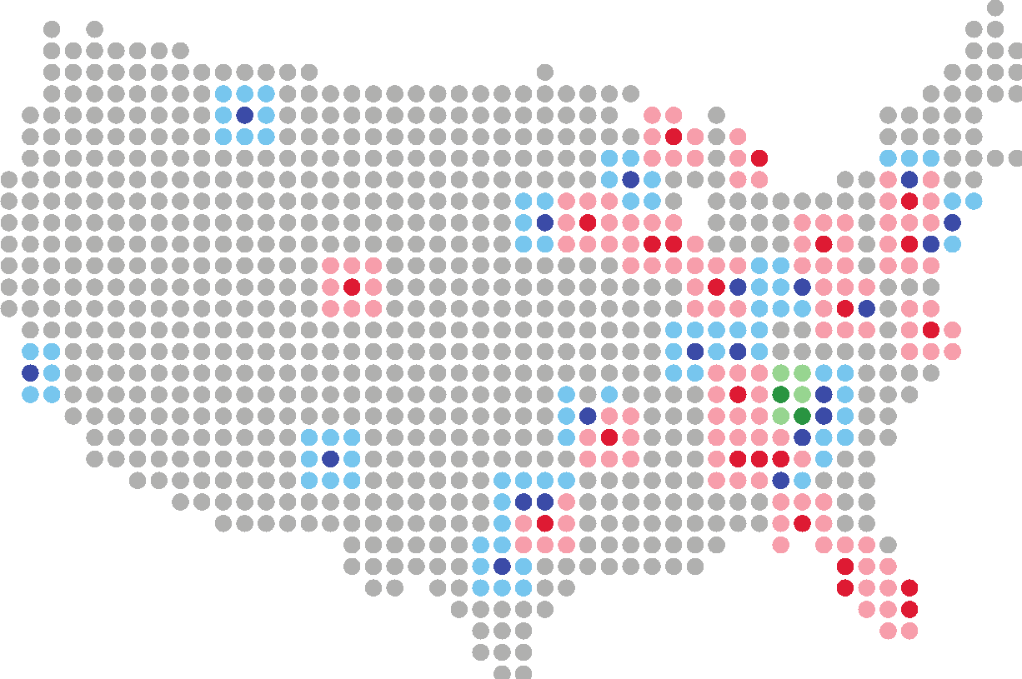
Equipping organizations with the tools they need to succeed to create sustainable programming for survivors of exploitation
Over 38 organizations mentored

Slide 15
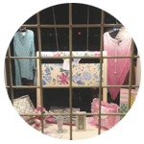
Wellspring Treasures
Peachtree City Treasures
116 Peachtree City East Shopping Ctr.
Peachtree City, GA 30269
Mon - Sat: 10AM - 6PM
Donations accepted until 4PM
Duluth Treasures
2785 Buford Highway, Suite 102-A
Duluth, GA 30096
Mon - Sat: 10AM - 6PM
Donations accepted until 4PM
Notes:
Our Retail stores help to fund our residential programs!!

Slide 16
HOW TO GET INVOLVED
Get Involved!
Be part of the solution
VOLUNTEER (Ongoing or Serve Day)
Website: wellspringliving.org/volunteer
Direct inquiries to volunteers@wellspringliving.org
DONATE (Monetary, Items, Clothing)
Website: wellspringliving.org/donate
Direct inquiries to srichardson@wellspringliving.org
ADVOCATE (Join our Speakers Bureau)
Website: wellspringliving.org/volunteer
Direct inquiries to volunteers@wellspringliving.org
Notes:
Review the Get Involved.pdf
Encourage the audience to get involved!

Slide 17
AREAS OF VOLUNTEERISM
RESIDENTIAL & COMMUNITY PROGRAMS
SERVE DAYS
SPEAKERS BUREAU ADVOCATES
LOGISTICS AND OPERATIONS SUPPORT
PRO TEAM
ANNUAL FUNDRAISING EVENTS
RETAIL STORES
Notes:
Residential & Community Programs – Provide hope, love and support to participants through assisting with academic tutoring, life-skills facilitation, building community bridges, providing transportation, mentoring and building personal relationships.
Serve Days– Individuals and groups serve together in fellowship on a single day to complete major projects such as construction, painting, deep cleaning, lawn care, etc. (www.wellspringliving.org/serve)
Speaker’s Bureau Advocates – A team devoted to advocating on behalf of Wellspring Living at major speaking events, at community information tables, as well as within personal social circles and social media.
Logistics and Operations Support– Help maintain and improve the facilities that house the women and girls, or help “behind the scenes” in several departments including finance, development and HR.
Pro Team – Exclusive group of skilled professional & seasoned amateurs who we can call on when we need experts
Annual Fundraising Events – Assist staff with event planning, on-site event activities, helping manage event-related data, or being a “megaphone” to help spread the word.
Retail Stores – Educate community members about DMST while assisting with day-to-day store operations and functions.

Slide 18
WHAT IS DMST?

Slide 19
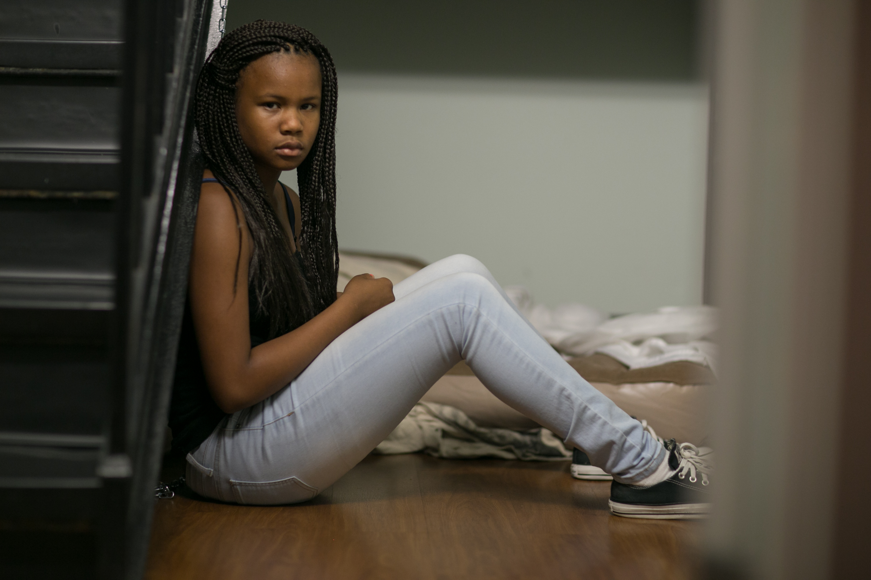
HUMAN TRAFFICKING
Domestic Minor Sex Trafficking (DMST)
Commercial Sexual Exploitation of Children (CSEC)
The exchange of a sexual act (street exploitation, pornography, cyber-based exploitation stripping, etc.) done for something of value.
Involves violence, threats, lies, debt bondage, and other forms of coercion used by sex traffickers to compel adults and children to engage in commercial sex acts against their will.
Under U.S. federal law, any person under the age of 18 induced into commercial sex, is a victim of sex trafficking — regardless of whether or not the trafficker used force, fraud, or coercion.
Notes:
Human trafficking is a form of modern-day slavery.
DMST is Domestic Minor Sex Trafficking. This occurs when minors are forced, coerced or otherwise involved in the commercial sex industry.
Despite how it may sound, trafficking does not require movement. A minor can be trafficked anywhere at any time and doesn’t even have to be moved beyond the boundaries of their own home to be a victim.
CSEC is the Commercial Sexual Exploitation of Children. This refers to a range of crimes and activities involving the sexual abuse or exploitation of a child for the financial benefit of any person or in exchange for anything of value (including monetary and non-monetary benefits) given or received by any person.
Under U.S. federal law, any person under the age of 18 induced into commercial sex, is a victim of sex trafficking — regardless of whether or not the trafficker used force, fraud, or coercion.

Slide 20
WHO CAN BE VICTIMS OF SEX TRAFFICKING?
Who can be victims of sex trafficking?
Spans ALL demographics
Some circumstances or vulnerabilities lead to a higher susceptibility to victimization and exploitation
HISTORY OF RUNNING AWAY
SEXUAL ASSAULT | DOMESTIC VIOLENCE
HOMELESS YOUTH | SUBSTANCE ABUSE
Notes:
While trafficking spans all demographics, there are some circumstances or vulnerabilities that lead to a higher susceptibility to victimization and exploitation.
FOR EXAMPLE:
Homelessness
Substance abuse
Chronic runaways
Victims of domestic violence
Victims of sexual assault
OTHER TRAITS OF VICTIMS TO LOOK OUT FOR INCLUDE:
Special marks, tattoos, or branding
A significantly older boyfriend/girlfriend
Multiple delinquent charges
New clothes, jewelry, or phone that cannot be accounted for
Sudden change in appearance or behavior

Slide 21
RECRUITMENT STRATEGIES
Recruitment Strategies
Seduction
Coercion
Peer Recruitment
Gangs
Kidnapping
Internet
Private Parties
Clubs/Music Business
Notes:
The situations that sex trafficking victims face vary dramatically.
Many victims become romantically involved with someone who then forces or manipulates them into prostitution.
Others are lured in with false promises of a job, such as modeling or dancing. Some are forced to sell sex by their parents or other family members.
They may be involved in a trafficking situation for a few days or weeks, or may remain in the same trafficking situation for years.

Slide 22
WHAT IT LOOKS LIKE DOMESTICALLY
What it looks like domestically
Roughly 25,000 runaways are reported annually
1 in 6 are likely to become sex trafficking victims
88% were in the care of social services when they went missing
Age is the primary factor of vulnerability
Pre-teen or adolescent girls are more susceptible to the calculated advances, deception, and manipulation tactics used by traffickers/pimps
The average age of an exploited child is 14 years old
Atlanta maintains one of the largest underground sex economies
In a 2014 report, the Urban Institute estimated that Atlanta has an underground sex economy of $290 million
Trafficking causes enormous short-term & long-term adverse consequences for the survivors: emotional, physical, cognitive, spiritual, life-expectancy
Notes:
As mentioned earlier runaways are identified as vulnerable populations and of the roughly 25,000 kids who run away annually, 1 in 6 are like to become sex trafficking victims. Of those 88% were in the care of social services when they went missing.
In terms of vulnerability, the primary factor is age. The average age of the exploited child is 14 years old, with an estimated 200-300,000 at risk each year in the United States.
Atlanta maintains one of the largest underground sex economies, with more than 100 girls being exploited an average of 3 times per night.
As you can imagine, trafficking causes enormous short-term and long-term adverse consequences for the survivors and this is why the work we do at Wellspring Living is so important.

Slide 23
Inform your audience:
HOW TO GET INVOLVED
Know the definition and thorough scope of the issue of sex trafficking/exploitation
Debunk the stigmas of the issue:
This is NOT a victimless crime
It can happen to ANYONE
Victims are often times targeted, groomed, and coerced by someone they know and trust!
* Familiarize yourself with current stats & local news stories

Slide 24
THE REALITY OF THE ISSUE OF TRAFFICKING IN METRO ATLANTA
Marietta sex trafficking
ring thwarted, police say
60 arrested in FBI-led child sex trafficking operation
Marietta Daily Journal
Atlanta Journal Constitution
Human trafficking brutal and widespread in Georgia
8 Women held against their will in nearly $1mil Sandy Springs home
WGCL-TV Atlanta
Atlanta Journal Constitution

Slide 25
THE REALITY OF THE ISSUE OF TRAFFICKING IN THE STATE OF GEORGIA
2017: 276 human trafficking cases reported; 19% of those involving minors
2017: Referrals from 134 Counties
Georgia Cares
National Human Trafficking Hotline
Youth are in the life an average of 6 ½ mos before being referred to a program
Average age served for the whole state is 12-14 years old
Georgia Cares
Georgia Cares
Notes:
Change slides for pictures

Slide 26
SUPER BOWL LIII – ATLANTA 2019
Wellspring Living was one of many nonprofit agencies across the state that worked together on awareness activities leading up to SB53:
Numerous trainings
Materials distribution to hotels and convenience stores
Awareness bus tours: “Hidden in Plain View”
STATS:
169 arrests – of those, 26 traffickers and 34 attempting to buy sex from minors
9 recoveries of minor victims (youngest was 14)
9 adult victims were identified
13 of 34 missing and at-risk kids in the Missing Children's Booklet were recovered within one week of Super Bowl!

Slide 27
Recent Victories in the Fight
November 2016: With over 83% of the vote, Georgia voters adopted the “Safe Harbor Act”
3/21/18: United States Senate passes SESTA (Stop Enabling Sex Traffickers Act of 2017)
4/6/18: The FBI seized and shut down backpage.com and affiliated websites with 7 executives indicted
2018 GA Legislative Session: Bills passed to increase penalties
2/26/19: Governor Brian Kemp and First Lady Marty Kemp announce their dedication to this cause with the creation of the GRACE commission
2019 GA Legislative Session: SB158 & HB234 – Anti-Human Trafficking Protective Response Act

Slide 28
Things to Remember...
HOW TO GET INVOLVED
Content does not always speak for itself. The communicator must speak the story.
- Stories: Excerpts from Wellspring Living books, YouTube channel,
personal experience (keeping confidentiality in mind), Wellspring Living Social Media channels (especially Facebook), etc.
You must have the heart, the passion, and the knowledge.
The story is often in the details!
Try to have good variety in your voice - rate, tone, inflection, etc.
Every speaking engagement is a real opportunity. You never know who is in that audience!
Practice, practice, practice!

Slide 29
Things to Avoid…
HOW TO GET INVOLVED
Going “off-script,” giving opinions and inaccurate (or outdated) statistics.
Speaking on unrelated topics (i.e. Discussing your political views and personal life)
Speaking longer than the requested time
Encouraging debate or arguing general issues surrounding the issue
Using terms like- prostitution/prostitute/escort

Slide 30
Next Steps
AFTER TRAINING:
1. You will receive an email with a link to our Speakers Bureau resource webpage: https://wellspringliving.org/speakers/
On this webpage, you will find:
- A copy of this power point
- Excerpts from The White Umbrella and Make it Zero
- Videos
- Links to additional outside resources
- Tips about Speaking from Executive Director, Mary Frances Bowley
- Link to post-event survey
2. Before taking your own event, you are required to shadow a current
speaker at an upcoming event.

Slide 31
Next Steps: Shadowing
HOW TO GET INVOLVED
SHADOWING:
1. When events come up, you will receive an email from events@wellspringliving.org
with the special event details.
2. Look at the date, location and details to see if it’s something you’d like to shadow.
3. Reply to the email indicating you are interested in shadowing.
*Shadowing opportunities are first come, first serve.
4. You will get a reply as to whether or not you are confirmed for the event.
- If you are confirmed: You will be introduced to the speaker via email and you
will get a calendar invitation
- If you are not, wait for the next event.
This step can take a while to complete, as there are many who are waiting to shadow. In the meantime, connect with our social media accounts, study our website, & keep up with resources to familiarize yourself as much as possible with our work!

Slide 32
Next Steps: Taking an Event
HOW TO GET INVOLVED
AFTER SHADOWING:
You will receive “OPEN: EVENT NAME” event invites (via calendar request) from events@wellspringliving.org. Review the details to see if you are available and interested in speaking. If, so reply back to Wellspring Living
*Speaking opportunities are first come, first serve.
2. After Wellspring Living confirms with you, mark your calendar and make sure
you “accept” the calendar invite. The overall event will be updated to say
“FILLED: YOUR NAME: EVENT NAME”
3. Wellspring Living will connect you with the event host. Reach out to the event
host (within 48-72 hours) to introduce yourself and learn more about the
event & expectations:
- Length of time you are expected to speak within the entire timeframe, Make-up of audience, Specific interests of group, etc.

Slide 33
Next Steps: Taking an Event
HOW TO GET INVOLVED
AFTER SHADOWING:
4. Pick-up Speakers Bureau box before event. Boxes are located:
Duluth Treasures store: (678) 578-6232
2785 Buford Highway, Suite 102-A // Duluth, GA 30096
Peachtree City Treasures store: (770) 632-1788
116 Peachtree City East Shopping Ctr. // Peachtree City, GA 30269
Main Office: 404-948-HOPE
1040 Boulevard SE, Suite M // Atlanta, GA 30312
*Note: Call any of the 3 locations before you pick-up to ensure box is there
5. Attend the event and spread the word about Wellspring Living!
6. Return box within 24-48 hours of the event.
7. Complete any requested follow-up and survey with designated Wellspring Living
staff person.

Slide 34
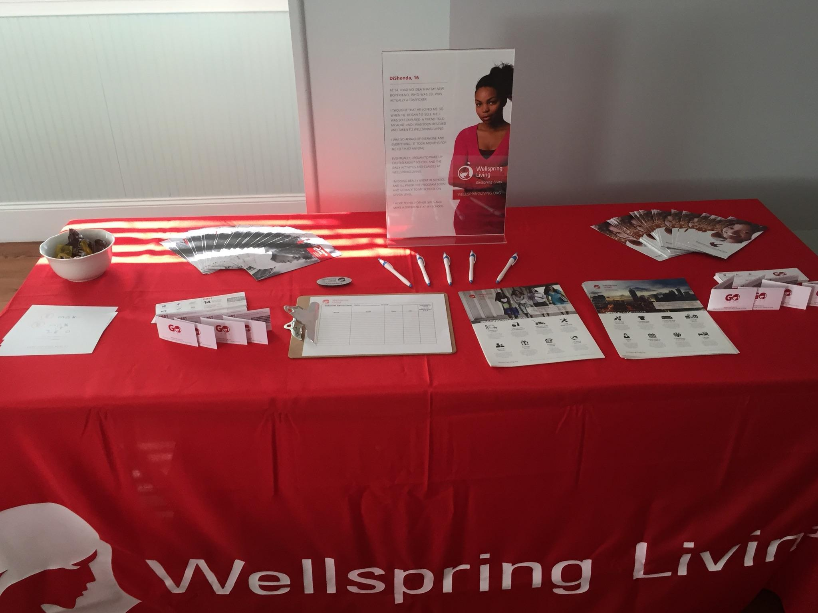
Example Event Set-Up
HOW TO GET INVOLVED
The Speakers Bureau boxes contain marketing materials and information you will want to share and help guide conversations.
Please make sure you are very familiar with the various pieces of materials!
Most events will include informational table set-up

Slide 35
QUESTIONS?

